Slide 1


Linear Models for Regression & Classification Week 3
Machine Learning for Data Analysis MSc in Data Analytics CCT College Dublin
Lecturer: Dr. Muhammad Iqbal*
Email: miqbal@cct.ie
©CCT College Dublin 2022

Slide 2
Agenda
Introduction to Regression
Regression Analysis
Linear Regression
Ridge Regression (L₂ Regularization)
Lasso Regression (L₁ Regularization)
Comparison of Linear, Ridge and Lasso Regression
Linear Regression for Multi-class classification
Linear and Logistic Regression
Strengths and Weaknesses

Slide 3
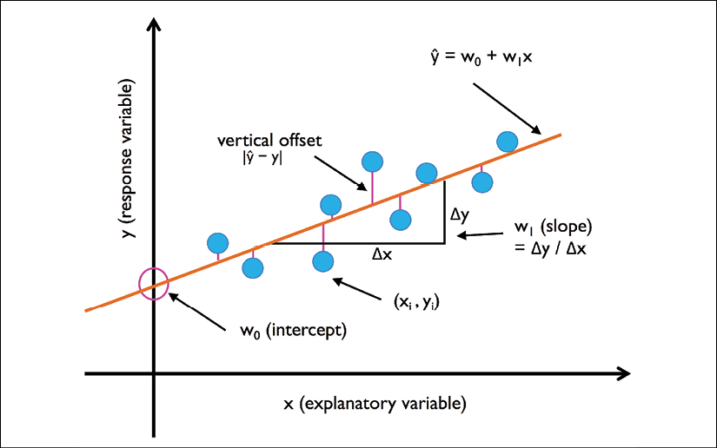
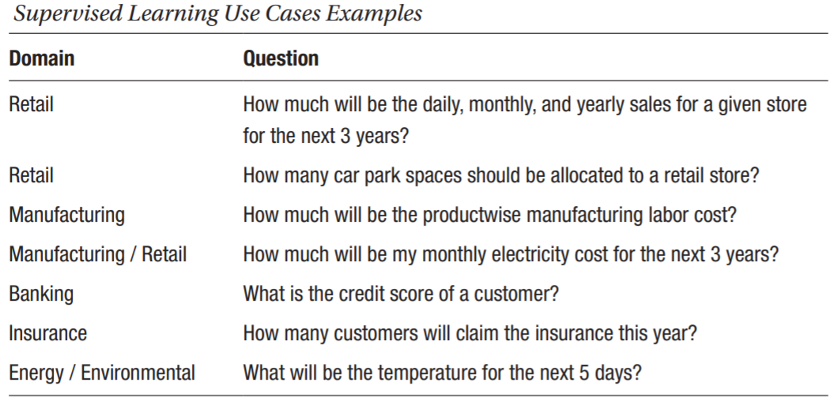
Introduction to Regression
Regression models are used to predict target variables on a continuous scale, which makes them attractive for addressing many questions in various fields.
They have applications in industry, such as understanding relationships between variables, evaluating trends, or making forecasts. One example is predicting the sales of a company in the future months.
Example: Estimate a patient’s systolic blood pressure, based on patient’s age, gender, body-mass index, and sodium levels.
Use training data to develop the model that estimates systolic blood pressure based on predictor variables.
Apply model to new cases in order to obtain estimated systolic blood pressure.

Slide 4
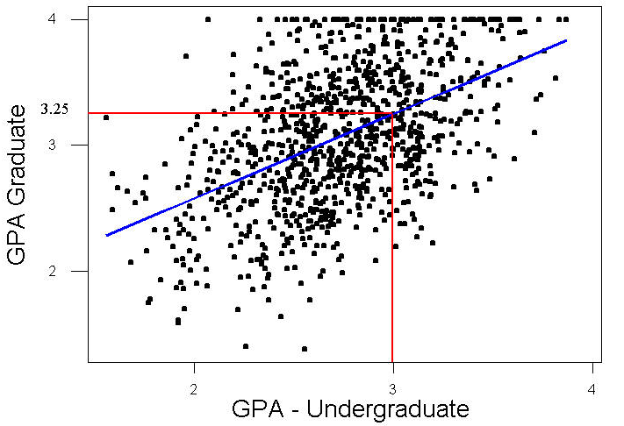
Introduction to Regression
Figure shows scatter plot of graduate GPA against undergraduate GPA (1000 students).
Linear regression finds line (blue) best approximating relationship between two variables.
Regression line estimates student’s graduate GPA based on their undergraduate GPA, resulting in the following model as w₀ = 1.24 and w₁ = 0.67.
ŷ = w₀ + w₁x => ŷ = 1.24 + 0.67x
For example, suppose student’s undergraduate GPA = 3.0
According to estimation model, the estimated student’s graduate GPA is
GPA = 1.24 + 0.67(3.0) = 3.25
Point (x = 3.0, ŷ = 3.25) lies on regression line
Methods used for classification and prediction applicable to prediction.
Includes point estimation, confidence interval estimation, linear regression and correlation, multiple regression, k-nearest neighbor, decision trees and neural networks.
Notes:
In statistics, point estimation involves the use of sample data to calculate a single value which is to serve as a "best guess" or "best estimate" of an unknown population parameter. More formally, it is the application of a point estimator to the data to obtain a point estimate.
In statistics, a confidence interval (CI) is a type of estimate computed from the observed data. This gives a range of values for an unknown parameter (for example, a population mean). The interval has an associated confidence level that gives the probability with which an estimated interval will contain the true value of the parameter. The confidence level is chosen by the investigator. For a given estimation in a given sample, using a higher confidence level generates a wider (i.e., less precise) confidence interval. In general terms, a confidence interval for an unknown parameter is based on sampling the distribution of a corresponding estimator.
GPA: Grade point average

Slide 5
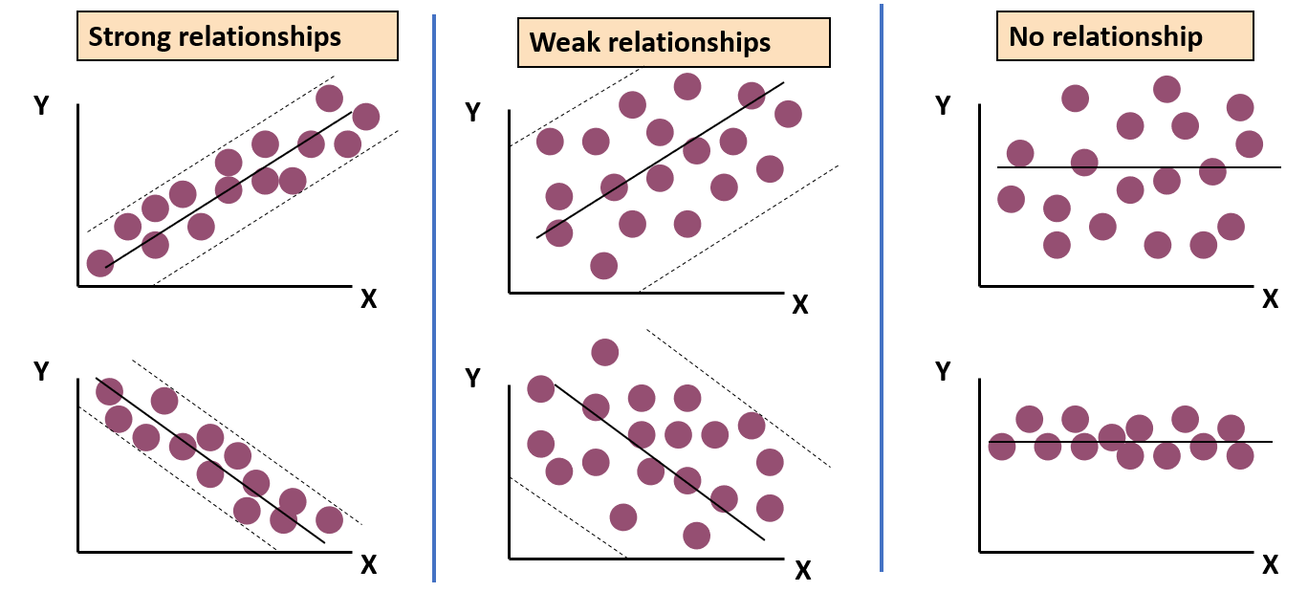


Regression Analysis
Regression analysis is used to
Predict the value of a dependent variable based on the value of at least one independent variable.
Explain the impact of changes in an independent variable on the dependent variable.
Dependent variable (Target variable)
The variable we wish to predict or explain.
Independent variable (Input features)
The variable used to predict or explain the dependent variable.
The goal is to find the best w₀ and w₁ values, we get the best fitting of the line. So, when we are finally using our model for prediction, it will predict the value of y for the input value of x.
While training the model, we are given x: input training data (univariate – one input variable (parameter)) y: labels to data (supervised learning)
When training the model, it fits the best line to predict the value of y for a given value of x. The model gets the best regression fit line by finding the best w₁ value. w₀: intercept or used symbol c w₁: coefficient of x

Slide 6
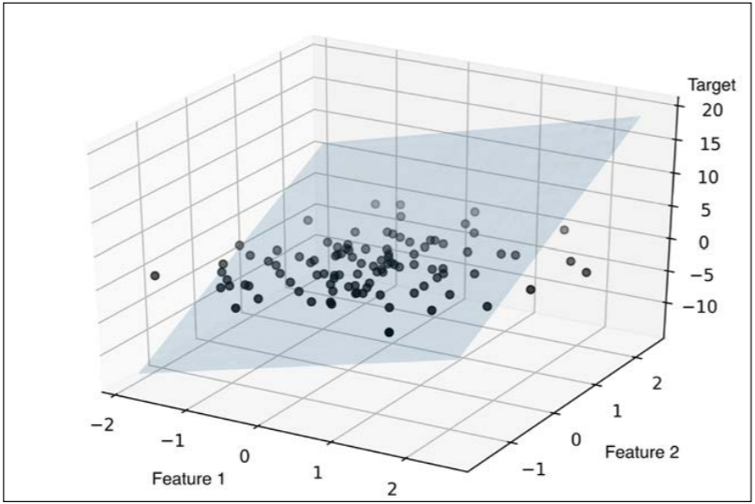
Linear Models
Linear models (LMs) are a class of models that are widely used in practice and LMs make a prediction using a linear function of the input features.
For multiple regression, the general prediction formula for a linear model is mentioned below
where x₁ to x_{m} shows the features (for example, columns/ attributes in a file) of a single data point, w[1…n] and w₀ are parameters of the model that are learned, and ŷ is the prediction the model makes. For a dataset with a single feature, we can mention as
ŷ = w[0] + w[1] * x[1]
w[1] is the slope and w[0] is the y-axis offset (y - intercept). For more features, w contains the slopes along each feature axis. Alternatively, we can think of the predicted response as being a weighted sum of the input features, with weights (which can be negative) given by the entries of w.
ŷ = w₀ + w₁x₁ + w₂x₂ + w₃x₃ + ... + w_{n}x_{n}
Visualizing multiple linear regression fits in 3-dimensional scatter plot.
Multiple regression is an extension of linear regression models that allow predictions of systems with multiple independent variables.
Notes:
Multiple Linear Regression does this by simply adding more terms to the linear regression equation, with each term representing the impact of a different physical parameter.

Slide 7
Linear Regression aka Ordinary Least Squares
Linear regression, or ordinary least squares (OLS), is the simplest and most classic linear method for Regression.
Linear regression finds the parameters w and c that minimize the mean squared error between predictions and the true regression targets, y, on the training set.
R² (coefficient of determination) Regression Score Function
Best possible score is 1.0 and it can be negative (because the model can be arbitrarily worse). A constant model that always predicts the expected value of y, disregarding the input features, would get a R² score of 0.0.
For example, R² of around 0.66 is not very good, but we can see that the scores on the training and test sets are very close together. This means we are likely underfitting, not overfitting.
For this one-dimensional dataset, there are less chances of overfitting, as the model is very simple (or restricted). With higher-dimensional datasets (meaning datasets with a large number of features), linear models become more powerful, and there is a higher chance of overfitting.
Notes:
The intercept_ attribute is always a single float number, while the coef_attribute is a NumPy array with one entry per input feature.
We only have a single input feature in the wave dataset, lr.coef_ only has a single entry.

Slide 8

Ridge Regression L₂ Regularization
Regularization means explicitly restricting a model to avoid overfitting. In order to create less complex model when we have a large number of features in the dataset, some of the Regularization techniques used to address over-fitting and feature selection from the dataset.
Ridge regression is a linear model for regression based on similar formula as we used for the linear regression (ordinary least squares). In ridge regression, the coefficients (w) are used for training the data, but also to fit an additional constraint.
L₂ regularization forces the weights to be small but does not make them zero and does non sparse solution. L₂ tends to shrink the coefficients evenly. The particular kind used by Ridge Regression is known as L₂ regularization.
Ridge regression adds “squared magnitude” of coefficient as penalty term to the loss function. It is clear from the highlighted part represents L₂ regularization element.
Cost function of Ridge Regression
Notes:
The goal of the cost function in linear ridge regression is to find the values of β that minimize the sum of squared differences while also penalizing large coefficients. The regularization term is crucial for balancing the trade-off between fitting the training data well and preventing the model from becoming too complex. It encourages the model to be simpler by discouraging overly complex relationships between features and the target variable.
In numerical analysis and scientific computing, a sparse matrix or sparse array is a matrix in which most of the elements are zero.
L1 tends to shrink coefficients to zero whereas L2 tends to shrink coefficients evenly. L1 is therefore useful for feature selection, as we can drop any variables associated with coefficients that go to zero. L2, on the other hand, is useful when you have collinear/codependent features.
https://medium.com/datadriveninvestor/l1-l2-regularization-7f1b4fe948f2

Slide 9
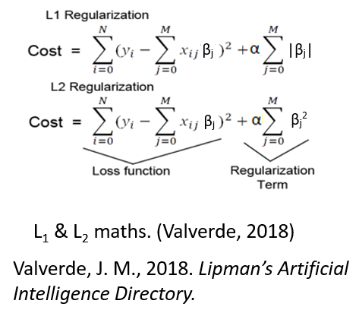
Comparison Linear and Ridge Regression
If we obtain the lower training set score using Ridge than LinearRegression, while the test set score is higher.
Ridge is a more restricted model and there are less chances of overfitting. A less complex model means worse performance on the training set, but better generalization.
We are always interested in generalization performance; we should choose the Ridge model over the LinearRegression model.
The Ridge model makes a trade-off between the simplicity of the model (near-zero coefficients) and its performance on the training set.
How much importance the model places on simplicity versus training set performance can be specified by the user, using the alpha (α) parameter.

Slide 10
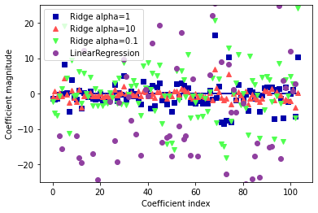
Ridge Regression Effect of alpha (α)
We can obtain best trade-off by tuning the alpha (α) parameter.
The optimum setting of alpha (α) depends on the particular dataset that we are using.
We can get a more qualitative insight into how the alpha (α) parameter changes the model by inspecting the coef_ attribute of models with different values of alpha (α).
A higher alpha (α) means a more restricted model, so we can expect the entries of coef_ to have smaller magnitude for a high value of alpha (α) than for a low value of alpha (α).
Comparing coefficient magnitudes for ridge regression with different values of alpha and linear regression
Notes:
The x-axis enumerates the entries of coef_: x = 0 shows the coefficient associated with the first feature, x = 1 the coefficient associated with the second feature, and so on up to x = 100.
The y-axis shows the numeric values of the corresponding values of the coefficients. It is evident when alpha = 10, the coefficients are mostly between around -3 and 3.
The coefficients for the Ridge model with alpha = 1 are somewhat larger. The dots corresponding to alpha = 0.1 have larger magnitude, and many of the dots corresponding to linear regression without any regularization (which would be alpha = 0) are so large they are outside of the chart.
Another way to understand the influence of regularization is to fix a value of alpha but vary the amount of training data available.

Slide 11

Lasso Regression L₁ Regularization
Lasso can be used as a substitute for Ridge when regularizing linear regression. Using the Lasso restricts coefficients in Ridge Regression to be near to zero in a similar but somewhat different manner known as L1 regularization.
The consequence of L₁ regularization is that when using the Lasso, some coefficients are exactly zero.
This means some features are entirely ignored by the model. Having some coefficients be exactly zero makes a model easier to interpret, and can reveal the most important features of your model.
Lasso Regression (Least Absolute Shrinkage and Selection Operator) adds “absolute value of magnitude” of coefficient as penalty term to the loss function. Let’s apply the Lasso to the extended Boston Housing dataset:
Cost function of Lasso Regression
Notes:
In case of Ridge Regression, if lambda is zero then you can imagine we get back OLS. However, if lambda is very large then it will add too much weight and it will lead to under-fitting. Having said that it’s important how lambda is chosen. This technique works very well to avoid over-fitting issue.
In case of Lasso Regression, if lambda is zero then we will get back OLS whereas very large value will make coefficients zero hence it will under-fit.

Slide 12
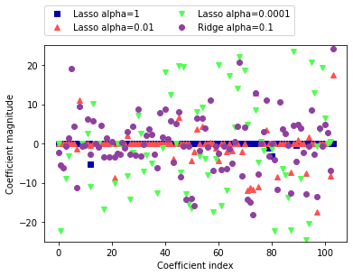
Comparison of CM Lasso Regression
For alpha (α) = 1, most of the coefficients are zero, but that the remaining coefficients are also small in magnitude.
For alpha (α) = 0.01, we obtain the solution shown as the red dots, which causes most features to be exactly zero.
For alpha (α) = 0.00001, we get a model that is quite unregularized, with most coefficients nonzero and of large magnitude as shown with green dots.
For comparison, the best Ridge solution is shown in teal.
The Ridge model with alpha (α) = 0.1 has similar predictive performance as the Lasso model with alpha (α) = 0.01, but using Ridge, all coefficients are nonzero.
CM: Coefficient magnitude
Comparing coefficient magnitudes for Lasso regression with different values of alpha and ridge regression
Notes:
Teal means having a dark greenish-blue colour
Coefficient Magnitudes: CM

Slide 13
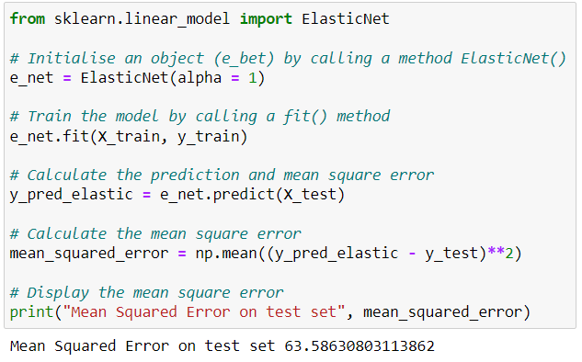
Comparison of CM Lasso Regression
Ridge Regression is the first choice between these two models.
Lasso would be a better option if we have a lot of features but only think a few of them will be crucial.
Similar to this, Lasso will offer a model that is simpler to comprehend and will only choose a portion of the input features if we want a model that is simple to read.
scikit-learn provides the ElasticNet class, which combines the penalties of Lasso and Ridge.
In practice, sometimes this combination works better, though at the price of having two parameters to adjust: one for the L₁ regularization, and one for the L₂ regularization.
Linear regression with combined L₁ and L₂ priors as regularizer.
alpha (α) value between 0 - 1 will perform an elastic net.
When alpha (α) = 0.5 we perform an equal combination of penalties whereas alpha (α) < 0.5 will have a heavier ridge penalty applied and alpha (α) > 0.5 will have a heavier Lasso penalty.

Slide 14
Linear Models Classification
Linear models are extensively used for classification. Let’s look at binary classification first.
In this case, a prediction is made using the following formula
f(x) = ŷ = w[0] * x[0] + w[1] * x[1] + ... + w[p] * x[p] + c > 0
The formula is fairly similar to that for linear regression, however we cutoff the projected value at zero rather than returning the weighted sum of the characteristics.
If the function (f(x)) is smaller than zero, we predict the class as -1; if it is larger than zero, we predict the class +1. This prediction rule is common to all linear models for classification.
So there are many different ways to find the coefficients (w) and the intercept (c).
Notes:
A regression model that uses L1 regularization technique is called Lasso Regression and model which uses L2 is called Ridge Regression. The key difference between these two is the penalty term. Ridge regression adds “squared magnitude” of coefficient as penalty term to the loss function.

Slide 15
Linear Models Classification
For linear models of regression, the output, ŷ, is a linear function of the features: a line, plane, or hyperplane (in higher dimensions).
For linear models of classification, the decision boundary is a linear function of the input.
There are many algorithms for learning linear models. These algorithms differ in the following two ways
The way in which they measure how well a particular combination of coefficients and intercept fits the training data
If and what kind of regularization they use
Different algorithms choose different ways to measure what “fitting the training set well” means.
Notes:
Regularization means explicitly restricting a model to avoid overfitting.

Slide 16
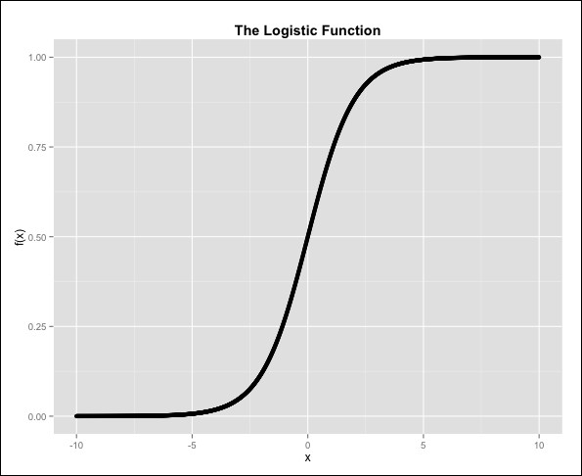


Logistic Regression
A supervised method that works for classification is logistic regression. Using the Logistic Sigmoid Function (f(x)), Logistic Regression, which is based on linear regression, changes its output and produces a probability value that maps various classes.
In Logistic Regression, the input features are linearly scaled as with linear regression.
The logistic function receives the outcome as an argument. This function applies a nonlinear transformation to the input and makes sure that the output's range, which may be seen as the likelihood that the input belongs to class 1, is within the range [0, 1].
The form of the logistic (Sigmoid) function is as follows
A Logistic regression is a widely used binary classifier (i.e., the target vector can only take two values). In the Logistic regression, a linear model (e.g., w₀ + w₁x) is included in the Logistic (also called sigmoid) function.
The effect of the logistic function is to constrain the value of the function’s output to between 0 and 1 so that it can be interpreted as the probability. If P(y_{i} = 1 | X) is greater than 0.5, class 1 is predicted; otherwise, class 0 is predicted.
Notes:
The number e, also known as Euler's number, is a mathematical constant approximately equal to 2.71828
where P(y_{i} = 1 | X) is the probability of the i^{th} observation’s target value, y_{i}, being class 1, X is the training data, w₀ and w₁ are the parameters to be learned, and e is Euler’s number.

Slide 17
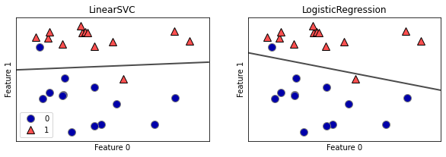
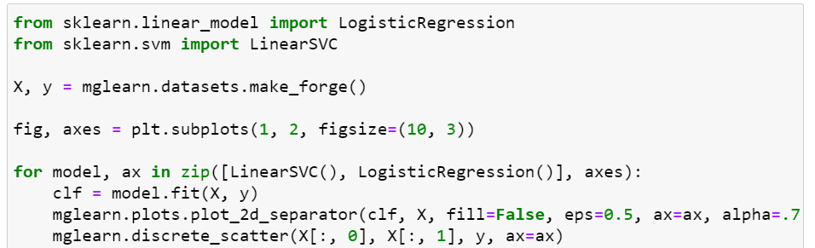
Linear and Logistic Regression
The two most common linear classification algorithms are Logistic regression, implemented in linear_model.LogisticRegression, and Linear support vector machines (linear SVMs), implemented in svm.LinearSVC (SVC stands for support vector classifier).
In the case of Linear Regression, the outcome is continuous while in the case of Logistic Regression, the outcome is discrete (not continuous) or categorical.
We can apply the LogisticRegression and LinearSVC models to the forge dataset, and visualize the decision boundary as found by the linear models.
Decision boundaries of a Linear SVM and Logistic regression on the forge dataset with the default parameters

Slide 18
Linear and Logistic Regression
We can see the decision boundaries found by LinearSVC and LogisticRegression respectively as straight lines, separating the area classified as class 1 on the top from the area classified as class 0 on the bottom (Feature 0 along x-axis and Feature 1 along y-axis)
Any new data point that lies above the black line will be classified as class 1 by the respective classifier, while any point that lies below the black line will be classified as class 0.
For LogisticRegression and LinearSVC, the trade-off parameter that determines the strength of the regularization is called C, and higher values of C correspond to less regularization.
If we use a high value of C, LogisticRegression and LinearSVC try to fit the training set as best as possible, while with low values of the parameter C, the models put more emphasis on finding a coefficient vector (w) that is close to zero.
Notes:
Regularization means explicitly restricting a model to avoid overfitting.

Slide 19
Linear Models Multiclass Classification
Many linear classification models are for binary classification only, and we need to extend to the multiclass case. A common technique to extend a binary classification algorithm to a multiclass classification algorithm is the one-vs.-rest approach.
In the one-vs.-rest approach, a binary model is learned for each class that tries to separate that class from all the other classes, resulting in as many binary models as there are classes.
To make a prediction, all binary classifiers are run on a test point. The classifier that has the highest score on its single class “wins,” and this class label is returned as the prediction.
Having one binary classifier per class results in having one vector of coefficients (w) and one intercept (c) for each class. The class for which the result of the classification confidence formula given is highest is the assigned class label
w[0] * x[0] + w[1] * x[1] + ... + w[p] * x[p] + c

Slide 20
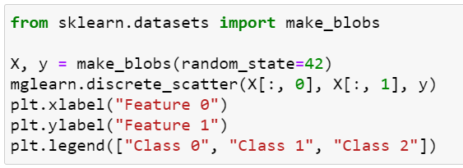
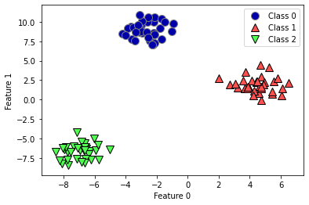
Linear Models Multiclass Classification
Let us apply the one-vs.-rest method to a simple three-class classification dataset.
We use a two-dimensional dataset, where each class is given by data sampled.
It is clear from the figure that the Two-dimensional toy dataset containing three classes.

Slide 21
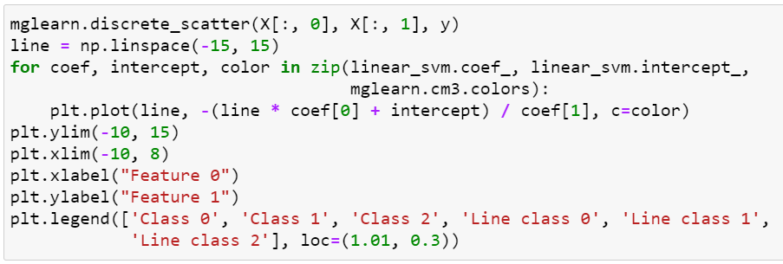
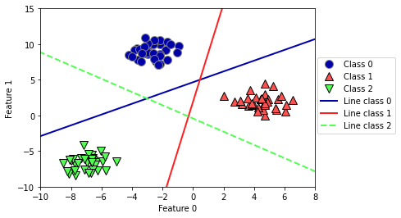
Two-dimensional Toy Dataset Three Classes
We can see that all the points belonging to class 0 in the training data are above the line corresponding to class 0, which means that they are on the “class 0” side of this binary classifier.
The points in class 0 are above the line corresponding to class 2, which means they are classified as “rest” by the binary classifier for class 2.
The points belonging to class 0 are to the left of the line corresponding to class 1, which means the binary classifier for class 1 also classifies them as “rest.”
Therefore, any point in this area will be classified as class 0 by the final.
How about the triangle in the plot's center? There, points are classified as "rest" by all three binary classifiers. Which class would be given that point? The class of the closest line, which has the highest value in the classification algorithm, is the correct response.
Decision boundaries learned by the three one-vs.-rest classifiers
Notes:
In the case of Linear Regression, the outcome is continuous while in the case of Logistic Regression outcome is discrete (not continuous)
To perform Linear regression we require a linear relationship between the dependent and independent variables. But to perform Logistic regression we do not require a linear relationship between the dependent and independent variables.
Linear Regression is all about fitting a straight line in the data while Logistic Regression is about fitting a curve to the data.
Linear Regression is a regression algorithm for Machine Learning while Logistic Regression is a classification Algorithm for machine learning.
Linear regression assumes Gaussian (or normal) distribution of the dependent variable. Logistic regression assumes the binomial distribution of the dependent variable.

Slide 22
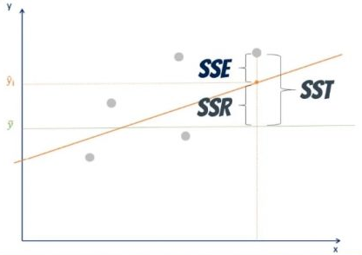

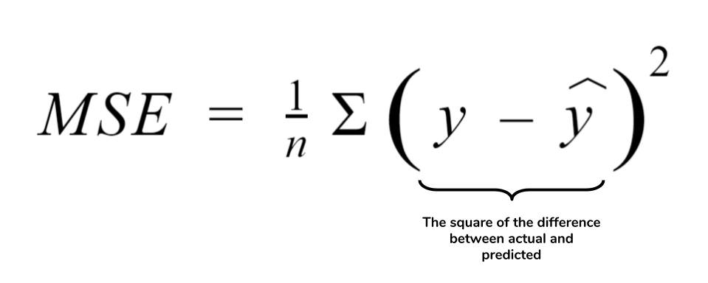
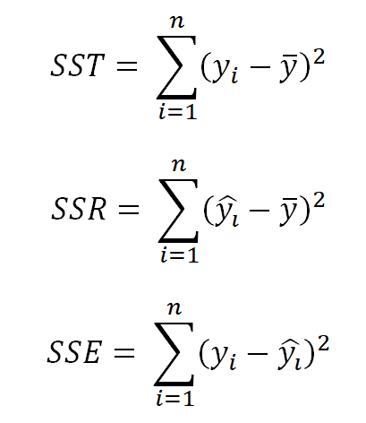


Measuring The Quality Of A Regression Model
A useful statistics is (s), the standard error of the estimate is calculated as
where SSE is the sum of squared errors. The statistic s is useful for assessing the quality of a regression model because its value indicates a measure of the size of the “typical” prediction error.
Another measure of the quality of a regression model is the r² (r-squared) statistic. r² measures how closely the linear regression fits the data, with values closer to 100% indicating a more perfect fit. The formula for r² is
Where SST represents the variability in the y-variable, and SSR represents the improvement in estimation from using the regression model as compared to just using to estimate y. Thus, r² may be interpreted as the ratio of the total variability in y that is accounted for by the linear relationship between x and y.
$$\overline{y}$$
Notes:
SST: Sum of Squares Total
SSR: Sum of squares due to regression

Slide 23
Strengths and Weaknesses
Linear models are very fast to train, and also fast to predict. They scale to very large datasets and work well with sparse data. This is true if the dataset has highly correlated features; in these cases, the coefficients might be hard to interpret.
Linear models perform well when the number of features is large compared to the number of samples.
They are applied to very huge datasets for the simple reason that other models cannot be trained. Other models might perform more generally in lower-dimensional spaces.
Large values for alpha or small values for C mean simple models. For the regression models, tuning these parameters is quite important.
The other decision we have to make is whether we want to use L₁ regularization or L₂ regularization. If we assume that only a few of features are important, we should use L₁.
The main parameter of linear models is the Regularization Parameter, called alpha in the regression models and C in LinearSVC and LogisticRegression.
Notes:
A variable with sparse data is one in which a relatively high percentage of the variable's cells do not contain actual data. Such "empty," or NA, values take up storage space in the file.

Slide 24
Resources/ References
Mastering Machine Learning with Python in Six Steps: A Practical Implementation Guide to Predictive Data Analytics Using Python Manohar Swamynathan, 1484249461, 2019, Apress.
Introduction to Machine Learning with Python, Andreas C. Müller and Sarah Guido, O'Reilly Publishers, 2017.
Data Mining And Machine Learning, Fundamental Concepts And Algorithms, MOHAMMED J. Zaki, Wagner Meira, Jr., Cambridge CB2 8BS, United Kingdom, 2020.
Discovering Knowledge In Data: An Introduction To Data Exploration, Second Edition, By Daniel Larose And Chantal Larose, John Wiley And Sons, Inc., 2014.
www.datacamp.com
www.analyticsvidhya.com/blog/2018/08/k-nearest-neighbor-introduction-regression-python
Some images are used from google search repository to enhance the level of learning.
Sample datasets for Regression: www.kaggle.com/tags/regression
Copyright Notice The following material has been communicated to you by or on behalf of CCT College Dublin in accordance with the Copyright and Related Rights Act 2000 (the Act). The material may be subject to copyright under the Act and any further reproduction, communication or distribution of this material must be in accordance with the Act. Do not remove this notice

